Slide 1
THERMOREGULATION IN TERRESTRIAL REPTILES
GROUP 3

Slide 2
OUTLINE
Introduction
Characteristics of reptiles
Terrestrial Reptiles
Thermoregulation in terrestrial reptiles
Conclusion
References

Slide 3
INTRODUCTION
Reptiles are air-breathing, cold-blooded or poikilothermic vertebrates that have scaly bodies rather than hair or feathers.
They inhabit a wide range of aquatic as well as terrestrial ecosystems
The most recent findings divide reptiles into the following groups:
Squamates
Tuataras
Testudines
Crocodilians

Slide 4
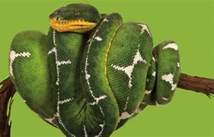
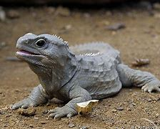
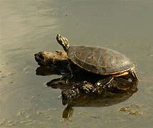
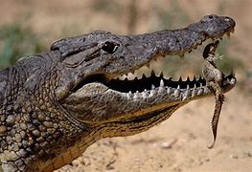
A Squamate
A Tuatara
A Testudine
A Crocodilian

Slide 5
CHARACTERISTICS OF REPTILES
Vertebrates.
Body covered with scales.
Cold-blooded.
Produce shelled eggs or bear live young ones.

Slide 6
TERRESTRIAL REPTILES
Terrestrial reptiles are reptile species that primarily inhabit and adapt to life on land.
Unlike amphibians and aquatic reptiles, terrestrial reptiles spend most, if not all, of their lives on land
These reptiles are well-suited to living in various terrestrial habitats.

Slide 7
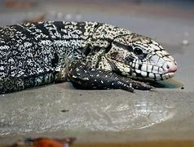
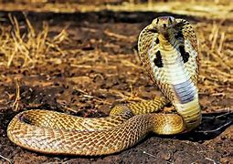
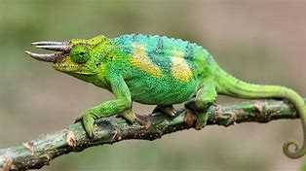
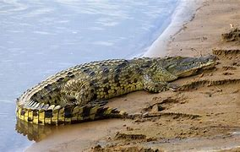
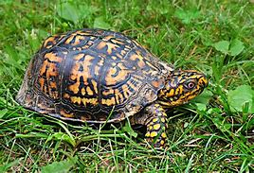
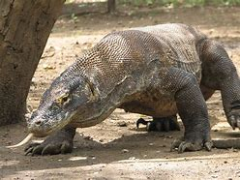
EXAMPLES OF TERRESTRIAL REPTILES
Argentine tegu lizard
King Cobra Snake
Jackson's Chameleon
Nile Crocodile
Eastern box turtle
Komodo Dragon

Slide 8
THERMOREGULATION IN TERRESTRIAL REPTILES
Thermoregulation is the ability of an organism to keep its body temperature within certain boundaries, even when the surrounding temperature is very different
There are three strategies that terrestrial reptiles use for thermoregulation:
Behavioral Adaptations
Physiological Adaptations

Slide 9
a) Behavioural thermoregulation
Basking
Shelter seeking
Posture and orientation
Burrowing

Slide 10
b)Physiological adaptation
Coloration
Scale structure
Blood flow regulation
Evaporative cooling

Slide 11
CONCLUSION
Adaptations in reptiles play a crucial role in their thermoregulation, enabling them to thrive in a wide range of environmental conditions. These adaptations highlight the incredible diversity and resilience of reptiles, allowing them to occupy various habitats.

Slide 12
REFERENCES
Savannah river ecology laboratory University of Georgia
Guyton & Hall (2006), pp. 891–892
Wilmore, Jack H., & Costill, David L. (1999). Physiology of sport and exercise (2nd ed).Champaign, Illinois: Human Kinetics.
Reptile: https://en.wikipedia.org/wiki/Reptile. Britannica. Accessed July 20, 2023.
Terrestrial reptile: https://www.sciencedirect.com/topics/earth-and-planetary-sciences/terrestrial-reptile. ScienceDirect. Accessed July 20, 2023.

Slide 13
GROUP MEMBERS
Forson Prince (9207619)
Mohammed Hafsa Bashir (9212819)
Boadi Princess Sophia (9204419)
Arthur Dorothy Otobbah (9201519)
Kosine Elsie Naa Adjaki (9221819)
Gyasi Philemon Kusi (9208819)

